Slide 1

Dynamic Healthcare Webapp
THE TECHNOCRATS
TEAM MEMBERS-
Aarushi Sharma (lead)
Prachi Singh
Kirti Kummangalam

Slide 2

Webapp
CareConnect
-Keeping you well

Slide 3
CareConnect
Machine Learning Based Covid Symptom Tracking
01
.
Geolocation features-check nearest hospital
02
Emergency contact facility-video chat/calling
03
04
Book beds in advance

Slide 4
Tech Stack !
Machine Learning enabled webapp
Backend as Django
Database Management
UI Design with AdobeXd
Responsive Frontend Design

Slide 5

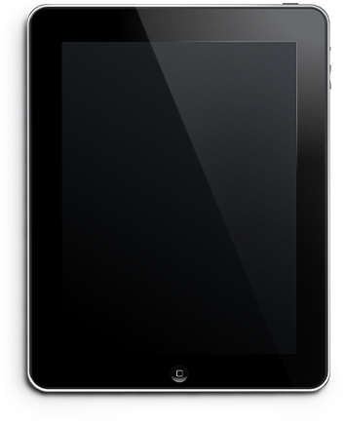
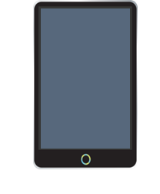

CareConnect

Slide 6

DYNAMIC WEBAPP AT YOUR EASE !
Feeling Unwell, Contact a health specialist right away !

Slide 7
UNIQUENESS OF OUR WEBAPP
AWESOME
FEATURES
Get accurate predictions with our ML based webapp
Self-analyse your health with our covid tracker
Get location of nearest hospital immediately

Slide 8

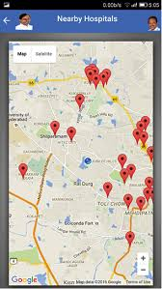
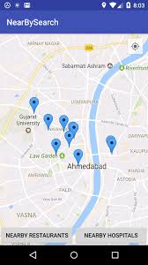
CareConnect
Do you need an online doctor now?
Do you want to reach nearest hospital?

Slide 9
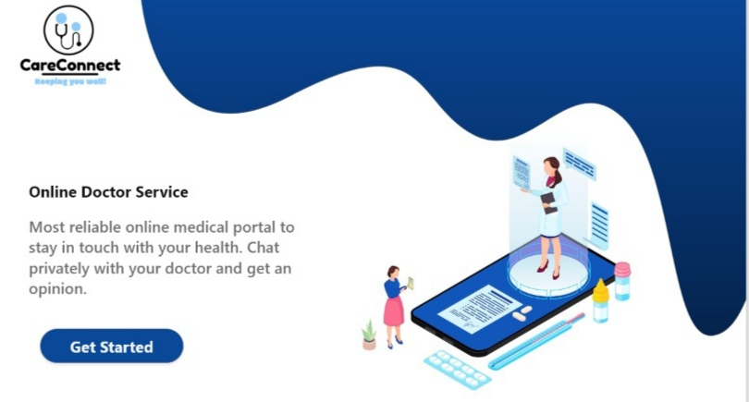
GLIMPSES
OF WEBAPP

Slide 10
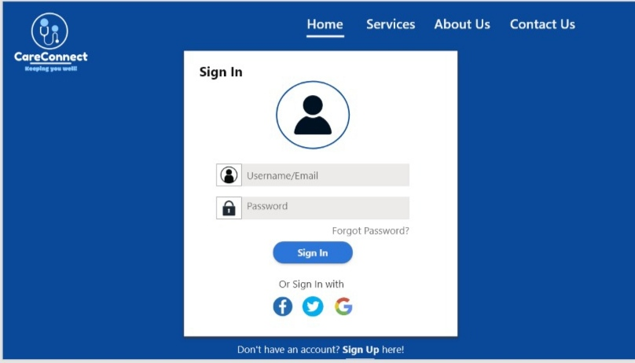
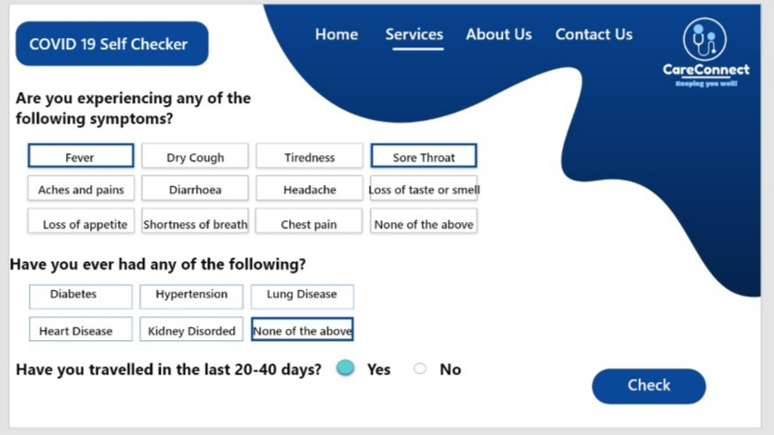
GLIMPSES
OF WEBAPP

Slide 11
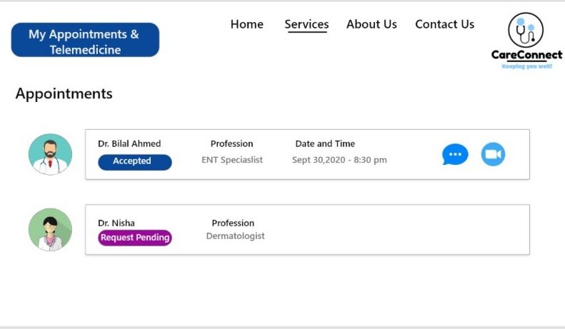

Slide 12
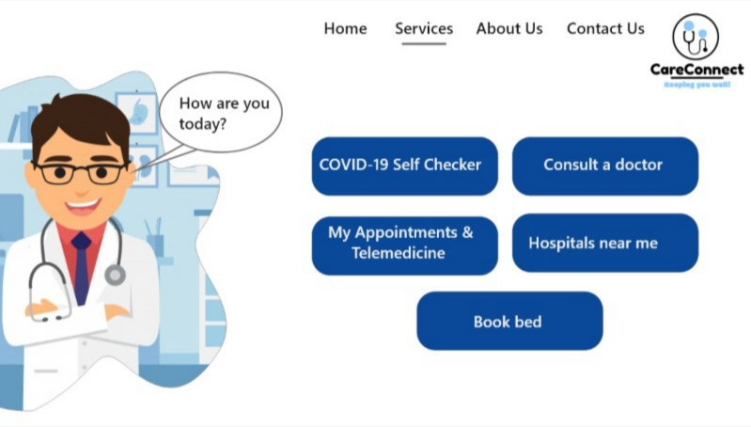
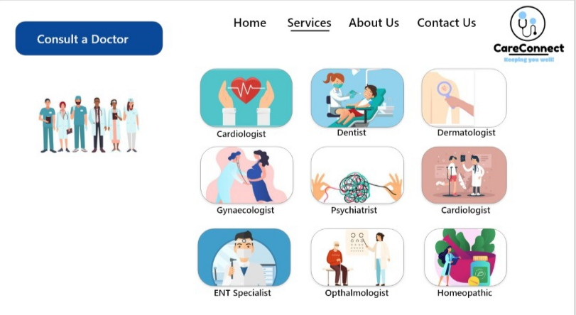
SOME MORE GLIMPSES

Slide 13
Thank You ☺

